Slide 1
Digital Portfolio
STUDENT NAME: suresh.s
REGISTER NO AND NMID:
DEPARTMENT: computerscience
COLLEGE: COLLEGE/ UNIVERSITY

Slide 2
PROJECT TITLE
Student portfolio

Slide 3


AGENDA
Problem Statement
Project Overview
End Users
Tools and Technologies
Portfolio design and Layout
Features and Functionality
Results and Screenshots
Conclusion
Github Link
3/21/2024 Annual Review

Slide 4

problem statement
The primary problem with student portfolios is the lack of an efficient, centralized system for managing and evaluating student work and progress, leading to issues like disorganization, time-consuming manual tracking, difficulty in providing structured feedback, and challenges for institutions in assessing overall performance and ensuring scalability and flexibility

Slide 5

PROJECT OVERVIEW
The primary problems with student portfolios include challenges for students in motivation, organization, and compilation of work, and for teachers in time commitment for preparation and assessment, increased workload, and potential subjectivity in evaluation

Slide 6

WHO ARE THE END USERS?
The proportion of each investment type retained is contingent upon the investor's objectives as well as the assets' risk and return attributes

Slide 7

TOOLS AND TECHNIQUES
the student, who uses it for self-reflection and to document their learning journey; the teacher, who uses it for assessment, feedback, and to identify learning gaps; and external parties such as parents, who can track their child's progress, and colleges or employers, who use it to evaluate a student's skills and accomplishments for admissions or job opportunities.

Slide 8
POTFOLIO DESIGN AND LAYOUT
good portfolio design layout is simple, intuitive, and highlights your best work. Key elements include bold visuals, clean text, a natural browsing flow, and clear separation of projects. You can choose from layouts such as full-screen, sliders, cards, or list formats to present your projects effectively.
8

Slide 9
FEATURES AND FUNCTIONALITY
Investment portfolio strategies range from aggressive accumulation to defensive preservation across investor risk appetites and market cycles. Growth portfolio.

Slide 10
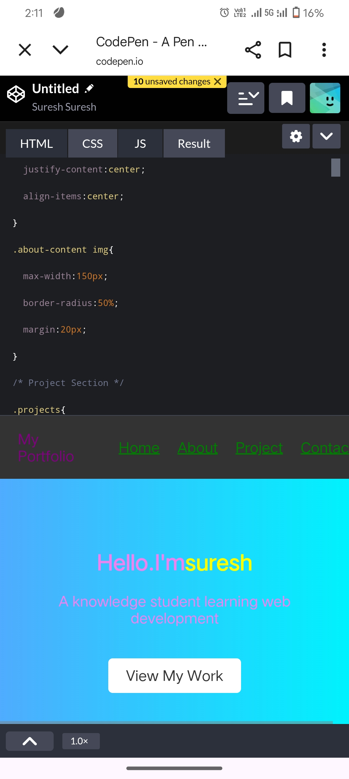

RESULTS AND SCREENSHOTS
3/21/2024 Annual Review
10

Slide 11
CONCLUSION
Thankyou
11

